Slide 1

Kubernetes Academy Kubernetes
31.10.2023
Michal Okresa

Slide 2
Agenda
Recapitulation – Kubernetes definition and components
Monolithic architecture / Microservices / Nanoservices / Functions / Serverless
Kubernetes Objects – theory & practice

Slide 3
Definition - recap
Kubernetes is a portable, extensible, open-source platform for managing containerized workloads and services, that facilitates both declarative configuration and automation,
It has a large, rapidly growing ecosystem,
Kubernetes services, support, and tools are widely available,
Possibility to add custom operators,
Many open standards are used in Kubernetes ecosystem like:
Open Container Initiative (OCI) - runC, OCISpec…,
Container Network Interface (CNI) – Calico, Flannel, Cilium…,
Container Runtime Interface (CRI) – Docker, containerd, CRI-O…,
Container Storage Interface (CSI) – Rook, CEPH…,
Service Mesh Interface (SMI) – Istio, Linkerd…,
Cloud Provider Interface (CPI) – AWS, Azure, GCP…

Slide 4
Components - recap
When you deploy Kubernetes, you get a cluster,
A Kubernetes cluster consists of a set of worker machines, called nodes (minions), that run containerized applications,
The control plane manages the worker nodes and the Pods in the cluster,
Every cluster has at least one worker node,
The worker node(s) host Pods that are the components of the application workload,
In production environments, the control plane usually runs across multiple computers and a cluster usually runs multiple nodes, providing fault-tolerance and high availability,

Slide 5
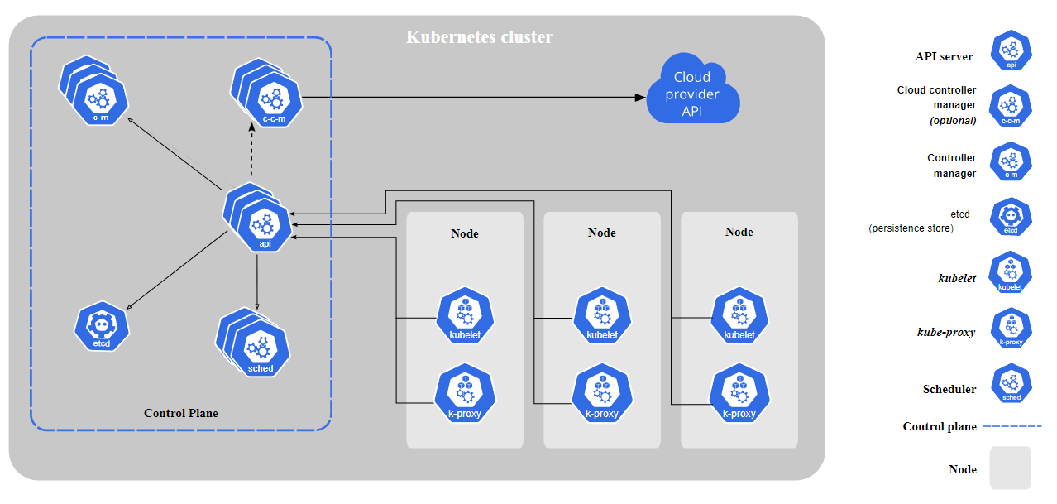
Components - recap

Slide 6
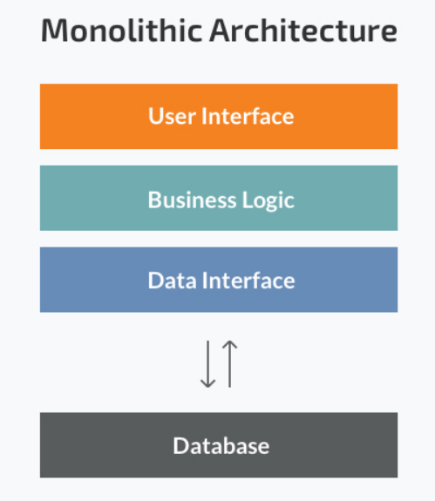
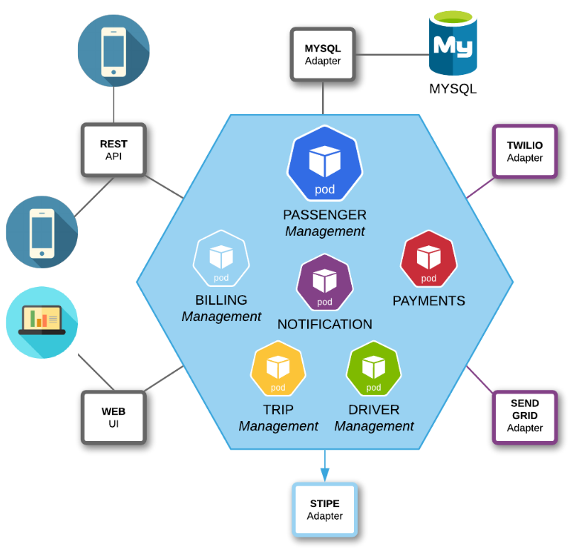
Monolithic architecture

Slide 7
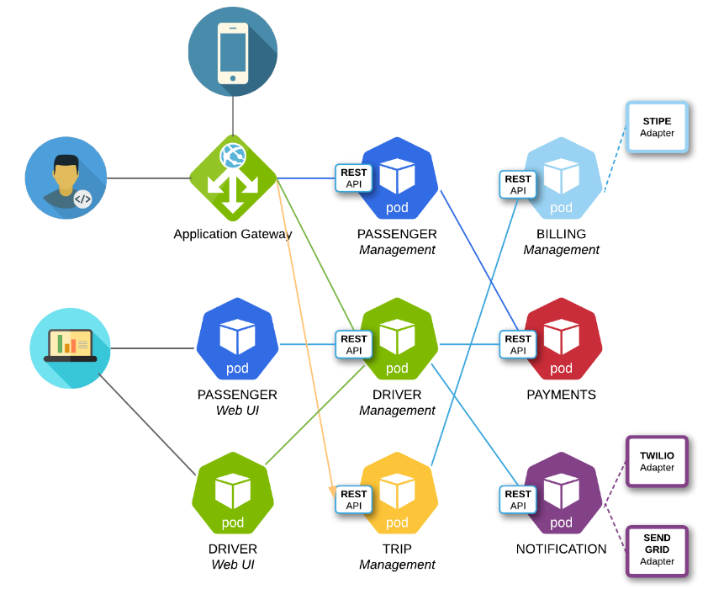
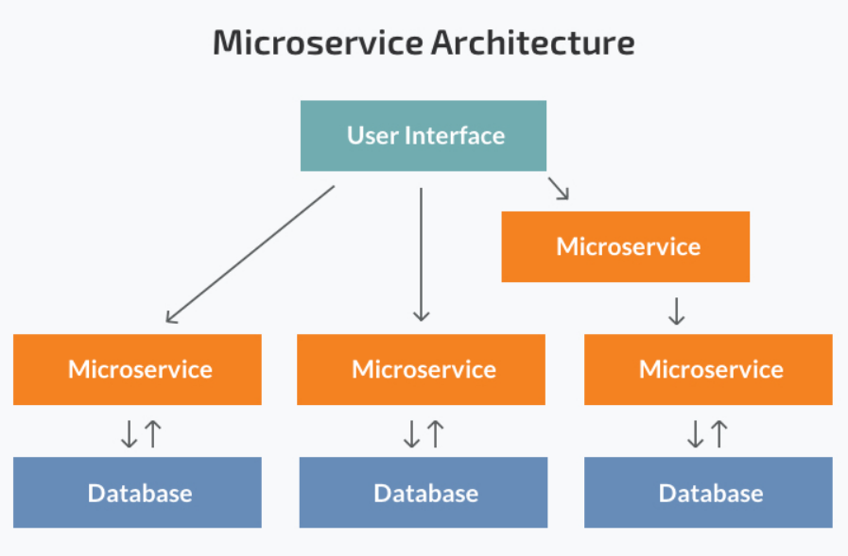
Microservices architecture

Slide 8
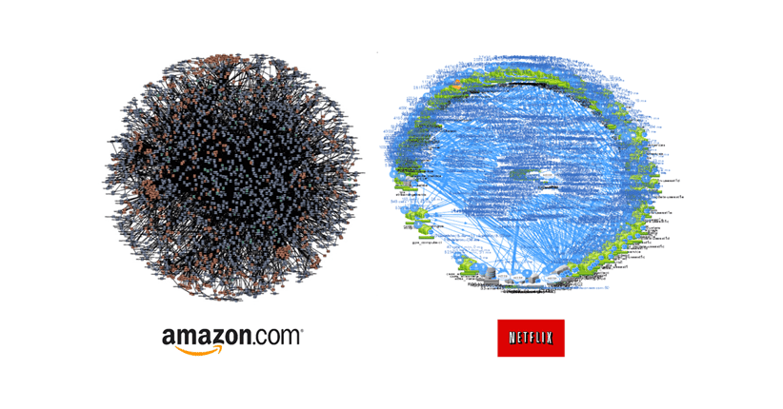

Slide 9
Minikube and k8s essentials

Slide 10

Minikube and k8s essentials
Minikube instance
minikube start --profile=twonodes --nodes=2 [--container-runtime=cri-o]
minikube profile list
minikube profile <profilename> #set default profile
Cluster status, view configuration
minikube status
kubectl cluster-info
nodes
minikube node list
kubectl get nodes -o wide
config
kubectl config view
~/.kube/config
Node access
minikube ssh --node twonodes
minikube ssh --node twonodes-m02
ps aux
Stop cluster, delete profile
minikube stop
minikube delete

Slide 11
K8s essentials
Verbose output (including API calls)
kubectl <command> -v6
kubectl get all -A -v6
Events
kubectl get events -n <namespace>
kubectl get events –A
Logs
kubectl logs -f <object> -n <namespace>

Slide 12
Minikube addons
Addons
minikube addons list
minikube addons enable dashboard
minikube addons enable metrics-server
minikube addons enable ingress
kubectl get all -A
Dashboard
minikube dashboard –url [--port 8080]
Access from remote machine via port forwarding
hostname –I #remote machine – to get remoteIP
ssh -L 8080:127.0.0.1:8080 <user>@<remoteIP> #local machine
Dashboard URL: http://127.0.0.1:8080/api/v1/namespaces/kubernetes-dashboard/services/http:kubernetes-dashboard:/proxy/

Slide 13
Container images used in examples
nginx
docker.io/nginx:latest
webserver
busybox
docker.io/busybox:latest
Universal image, we will use it for testing and scripting
http-echo
docker.io/hashicorp/http-echo
Simple “echo” server

Slide 14
Kubernetes Objects – theory & practice

Slide 15
Kubernetes objects
Kubernetes objects are persistent entities in the Kubernetes system. Kubernetes uses these entities to represent the state of your cluster. Specifically, they can describe:
What containerized applications are running (and on which nodes)
The resources available to those applications
The policies around how those applications behave, such as restart policies, upgrades, and fault-tolerance
kubectl api-resources
kubectl explain <type>.<fieldName>[.<fieldName>]
kubectl explain pod
kubectl explain pod.spec.containers.image

Slide 16
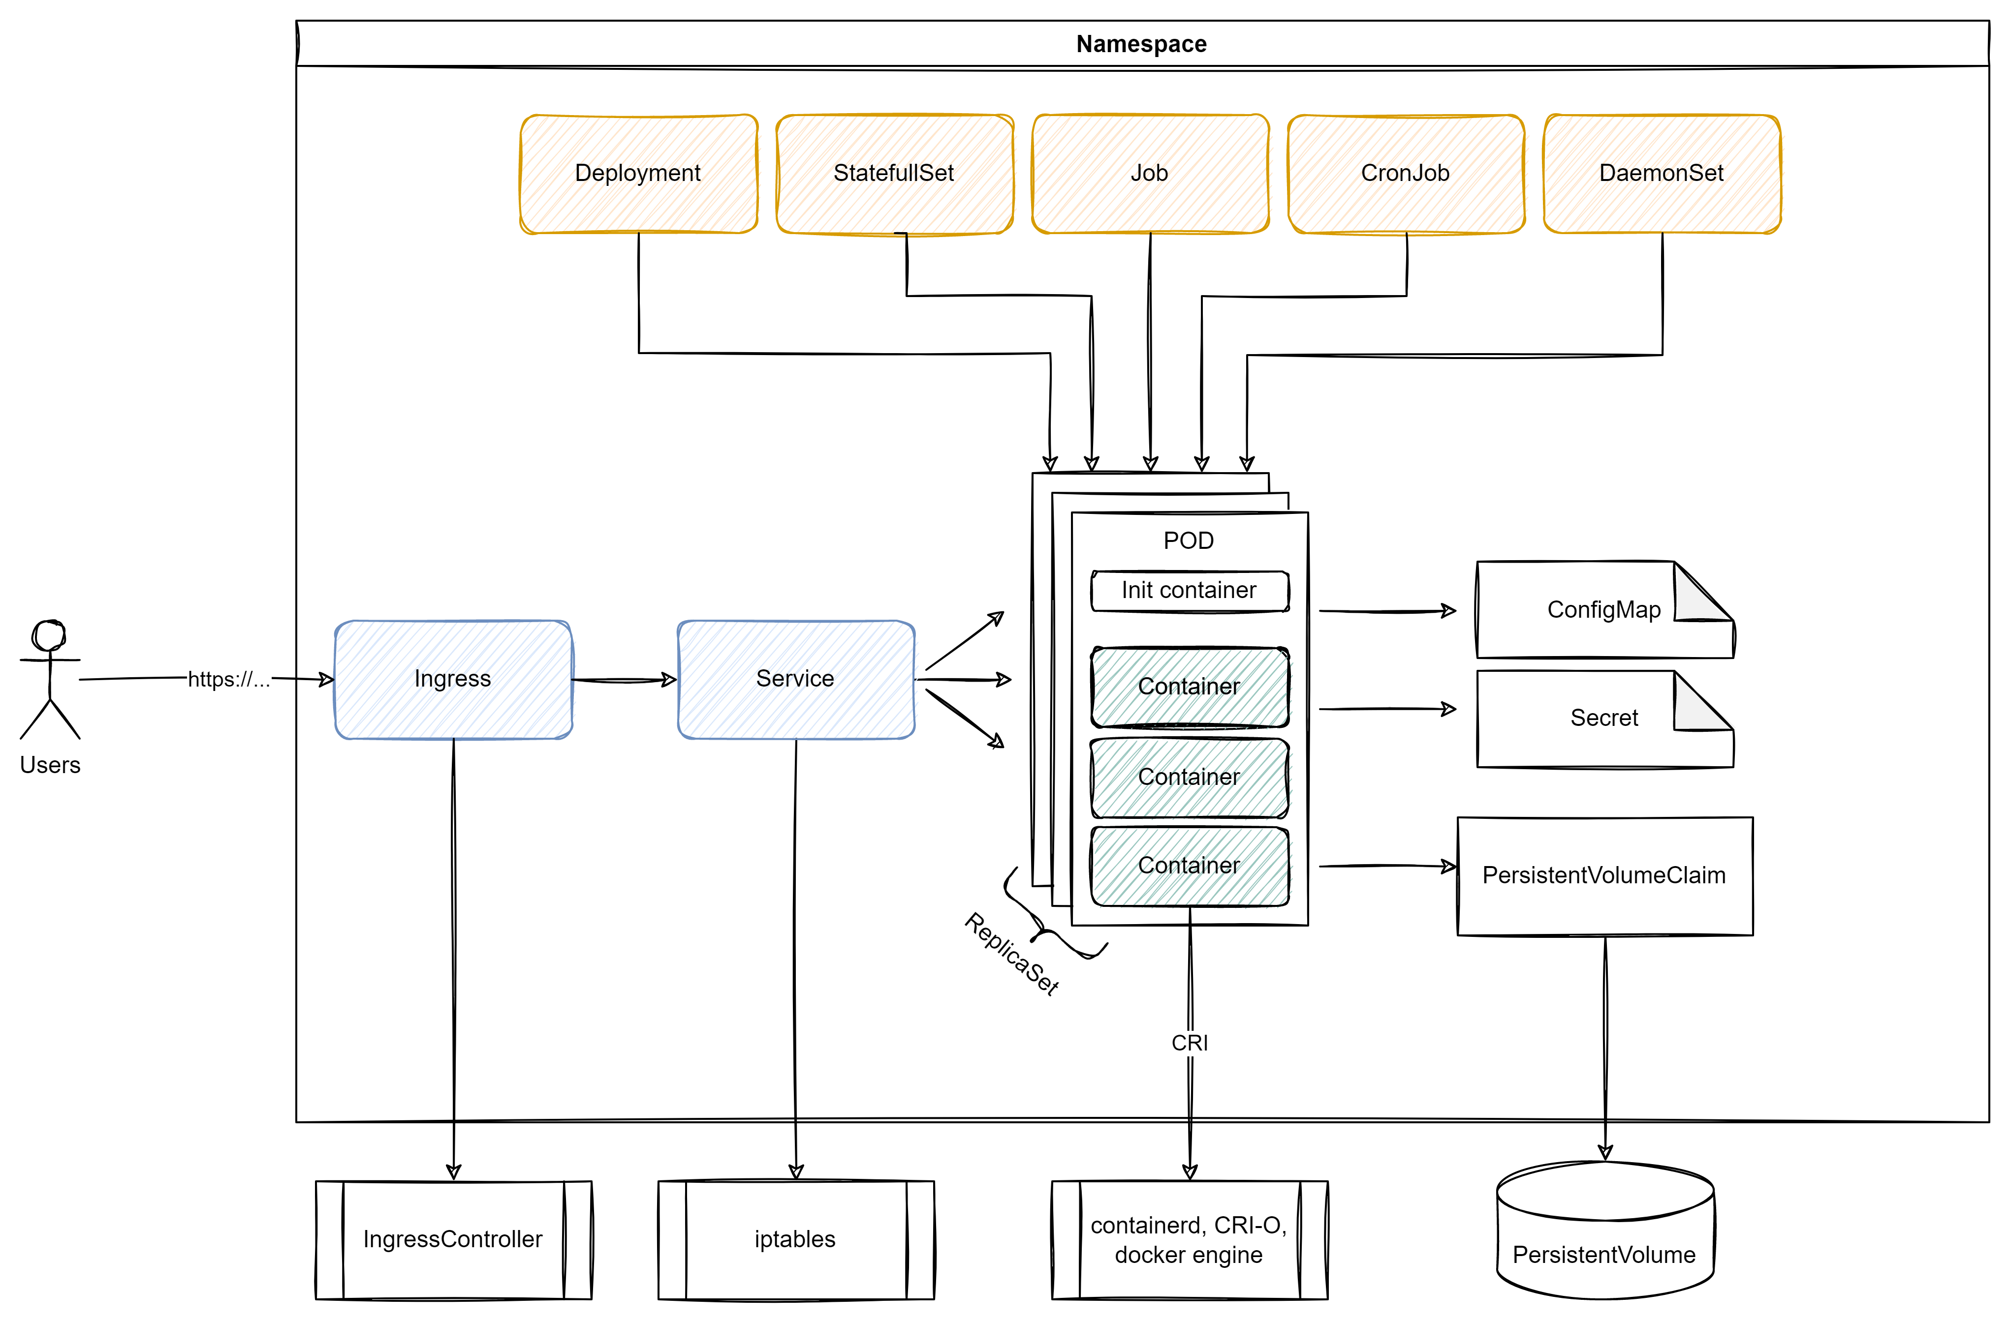
Application example

Slide 17
Namespace
Kubernetes supports multiple virtual clusters backed by the same physical cluster. These virtual clusters are called namespaces,
Namespaces provide a scope for names. Names of resources need to be unique within a namespace, but not across namespaces. Namespaces cannot be nested inside one another, and each Kubernetes resource can only be in one namespace,
Hierarchical namespaces(HNC) are provided as an extension (not part of official Kubernetes)
It is not necessary to use multiple namespaces just to separate slightly different resources, such as different versions of the same software: use labels to distinguish resources within the same namespace.
kubectl explain namespace
kubectl create namespace ns1; kubectl label ns ns1 team=t1
kubectl describe ns ns1

Slide 18
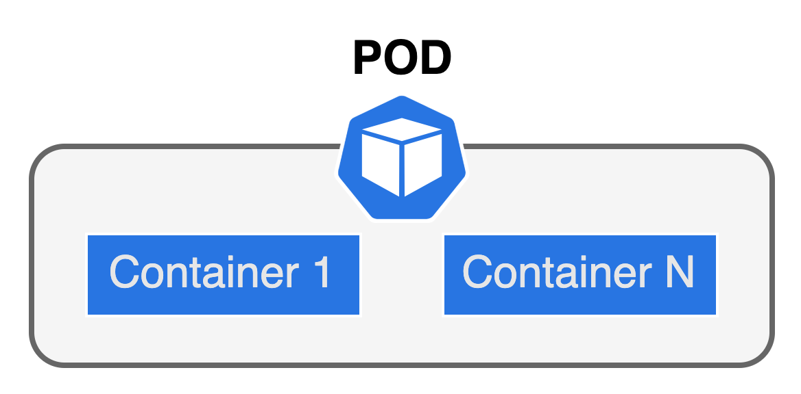
Pod (workload resource)
The whole point of Kubernetes is to orchestrate the life cycle of a container. We do not interact with containers. Instead, the smallest unit we can work with is a Pod,
Multi-container PODs
Share network and storage resources.
There is only one IP address per Pod with most network plugins. To communicate with each other, they can use IPC, the loopback interface, or a shared filesystem.
Patterns: sidecar (i.e. logging agent), adapter (i.e. data processor), ambassador (i.e. proxy).
Init containers: They are are run before the app containers are started.
Init containers always run to completion.
Each init container must complete successfully before the next one starts.

Slide 19
Pod
Examples 1-4

Slide 20
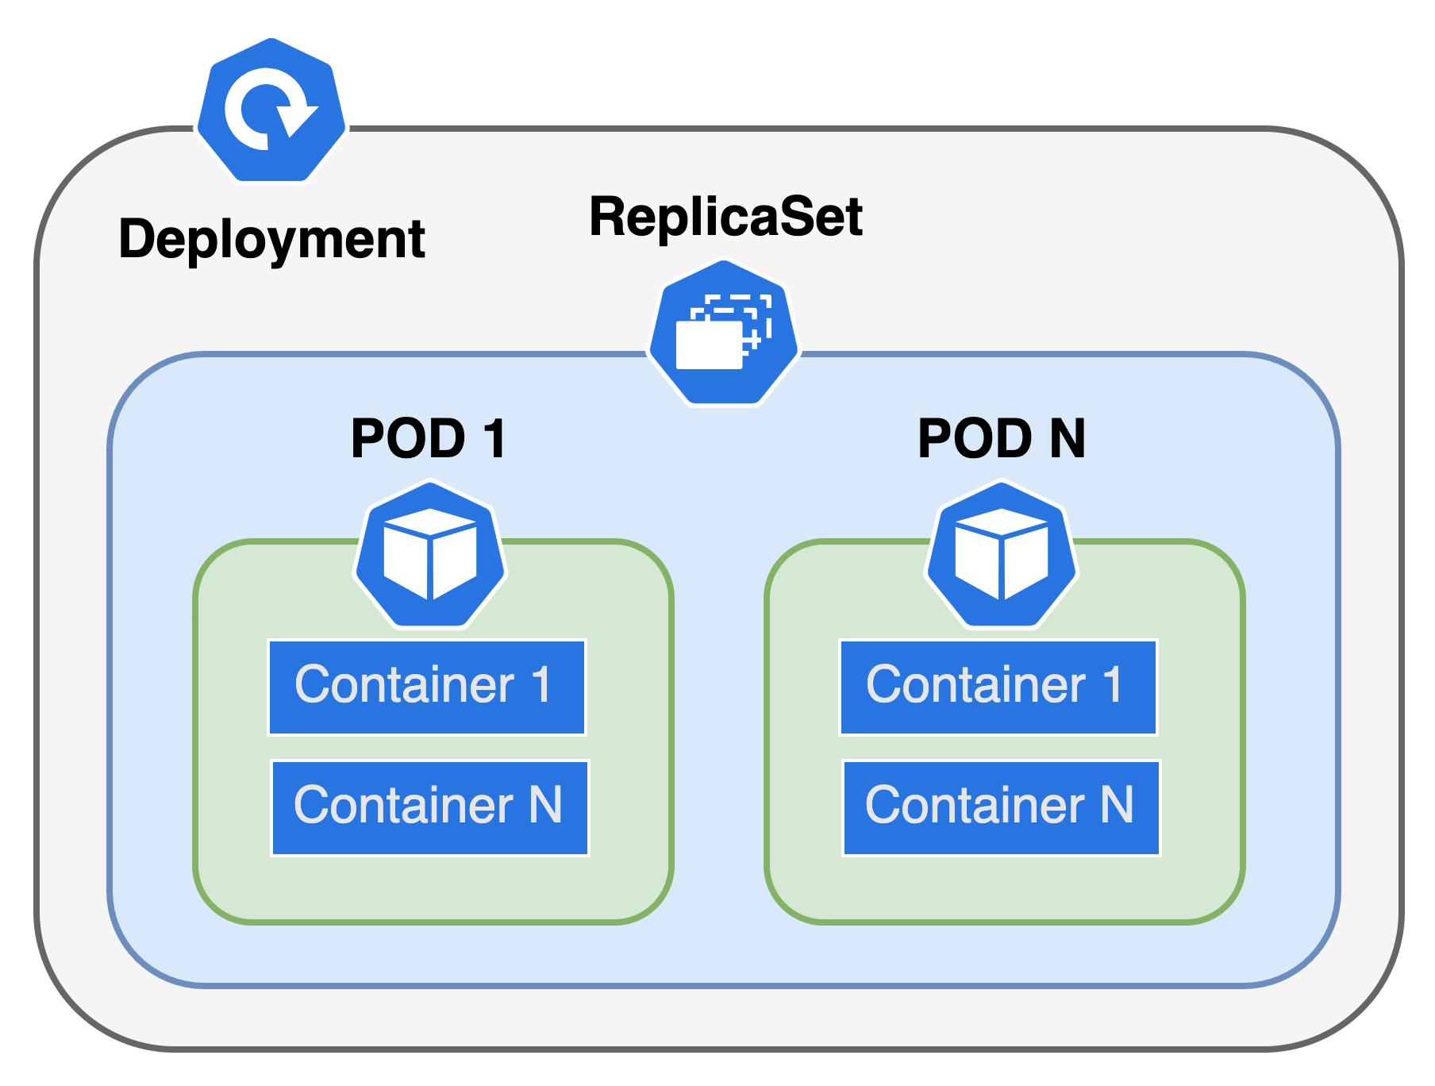
Deployment (workload resource)
A Deployment provides declarative updates for Pods and ReplicaSets,
You describe a desired state in a Deployment, and the Deployment Controller changes the actual state to the desired state at a controlled rate,

Slide 21
Deployment (workload resource)
Typical use cases:
Create a Deployment to rollout a ReplicaSet,
Declare the new state of the Pods by updating the PodTemplateSpec of the Deployment,
A new ReplicaSet is created, and the Deployment manages moving the Pods from the old ReplicaSet to the new one at a controlled rate,
Rollback to an earlier Deployment revision if the current state of the Deployment is not stable,
Scale up the Deployment to facilitate more load,
Pause the Deployment to apply multiple fixes to its PodTemplateSpec and then resume it to start a new rollout,
Use the status of the Deployment as an indicator that a rollout has stuck,
Clean up older ReplicaSets that you don't need anymore.
Example 5

Slide 22
DNS in K8S (PODs)
In general, a Pod has the following DNS resolution:
pod-ip-address.my-namespace.pod.cluster-domain.example.
For example, if a Pod in the default namespace has the IP address 172.17.0.3, and the domain name for your cluster is cluster.local, then the Pod has a DNS name:
172-17-0-3.default.pod.cluster.local.

Slide 23
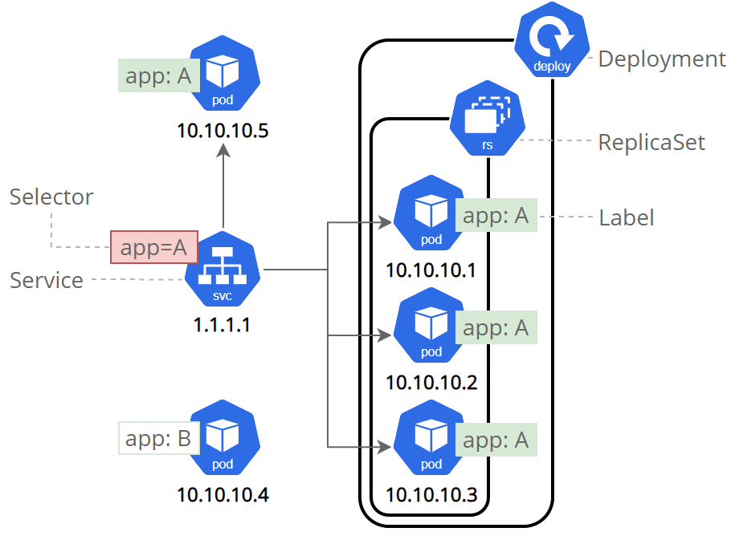
Service Resources
Service
Service is an abstract way to expose an application running on a set of Pods as a network service. With Kubernetes you don't need to modify your application to use an unfamiliar service discovery mechanism. Kubernetes gives Pods their own IP addresses and a single DNS name for a set of Pods and can load-balance across them.
Types:
ClusterIP – expose app only inside cluster
NodePort – expose app to node IP
Loadbalancer – only for public clouds azure, google cloud etc. It will create loadbalancer and expose application on this loadbalancer
ExternalName - map a Service to a DNS name, not to a typical selector (may not work properly with http, https and other protocols)

Slide 24
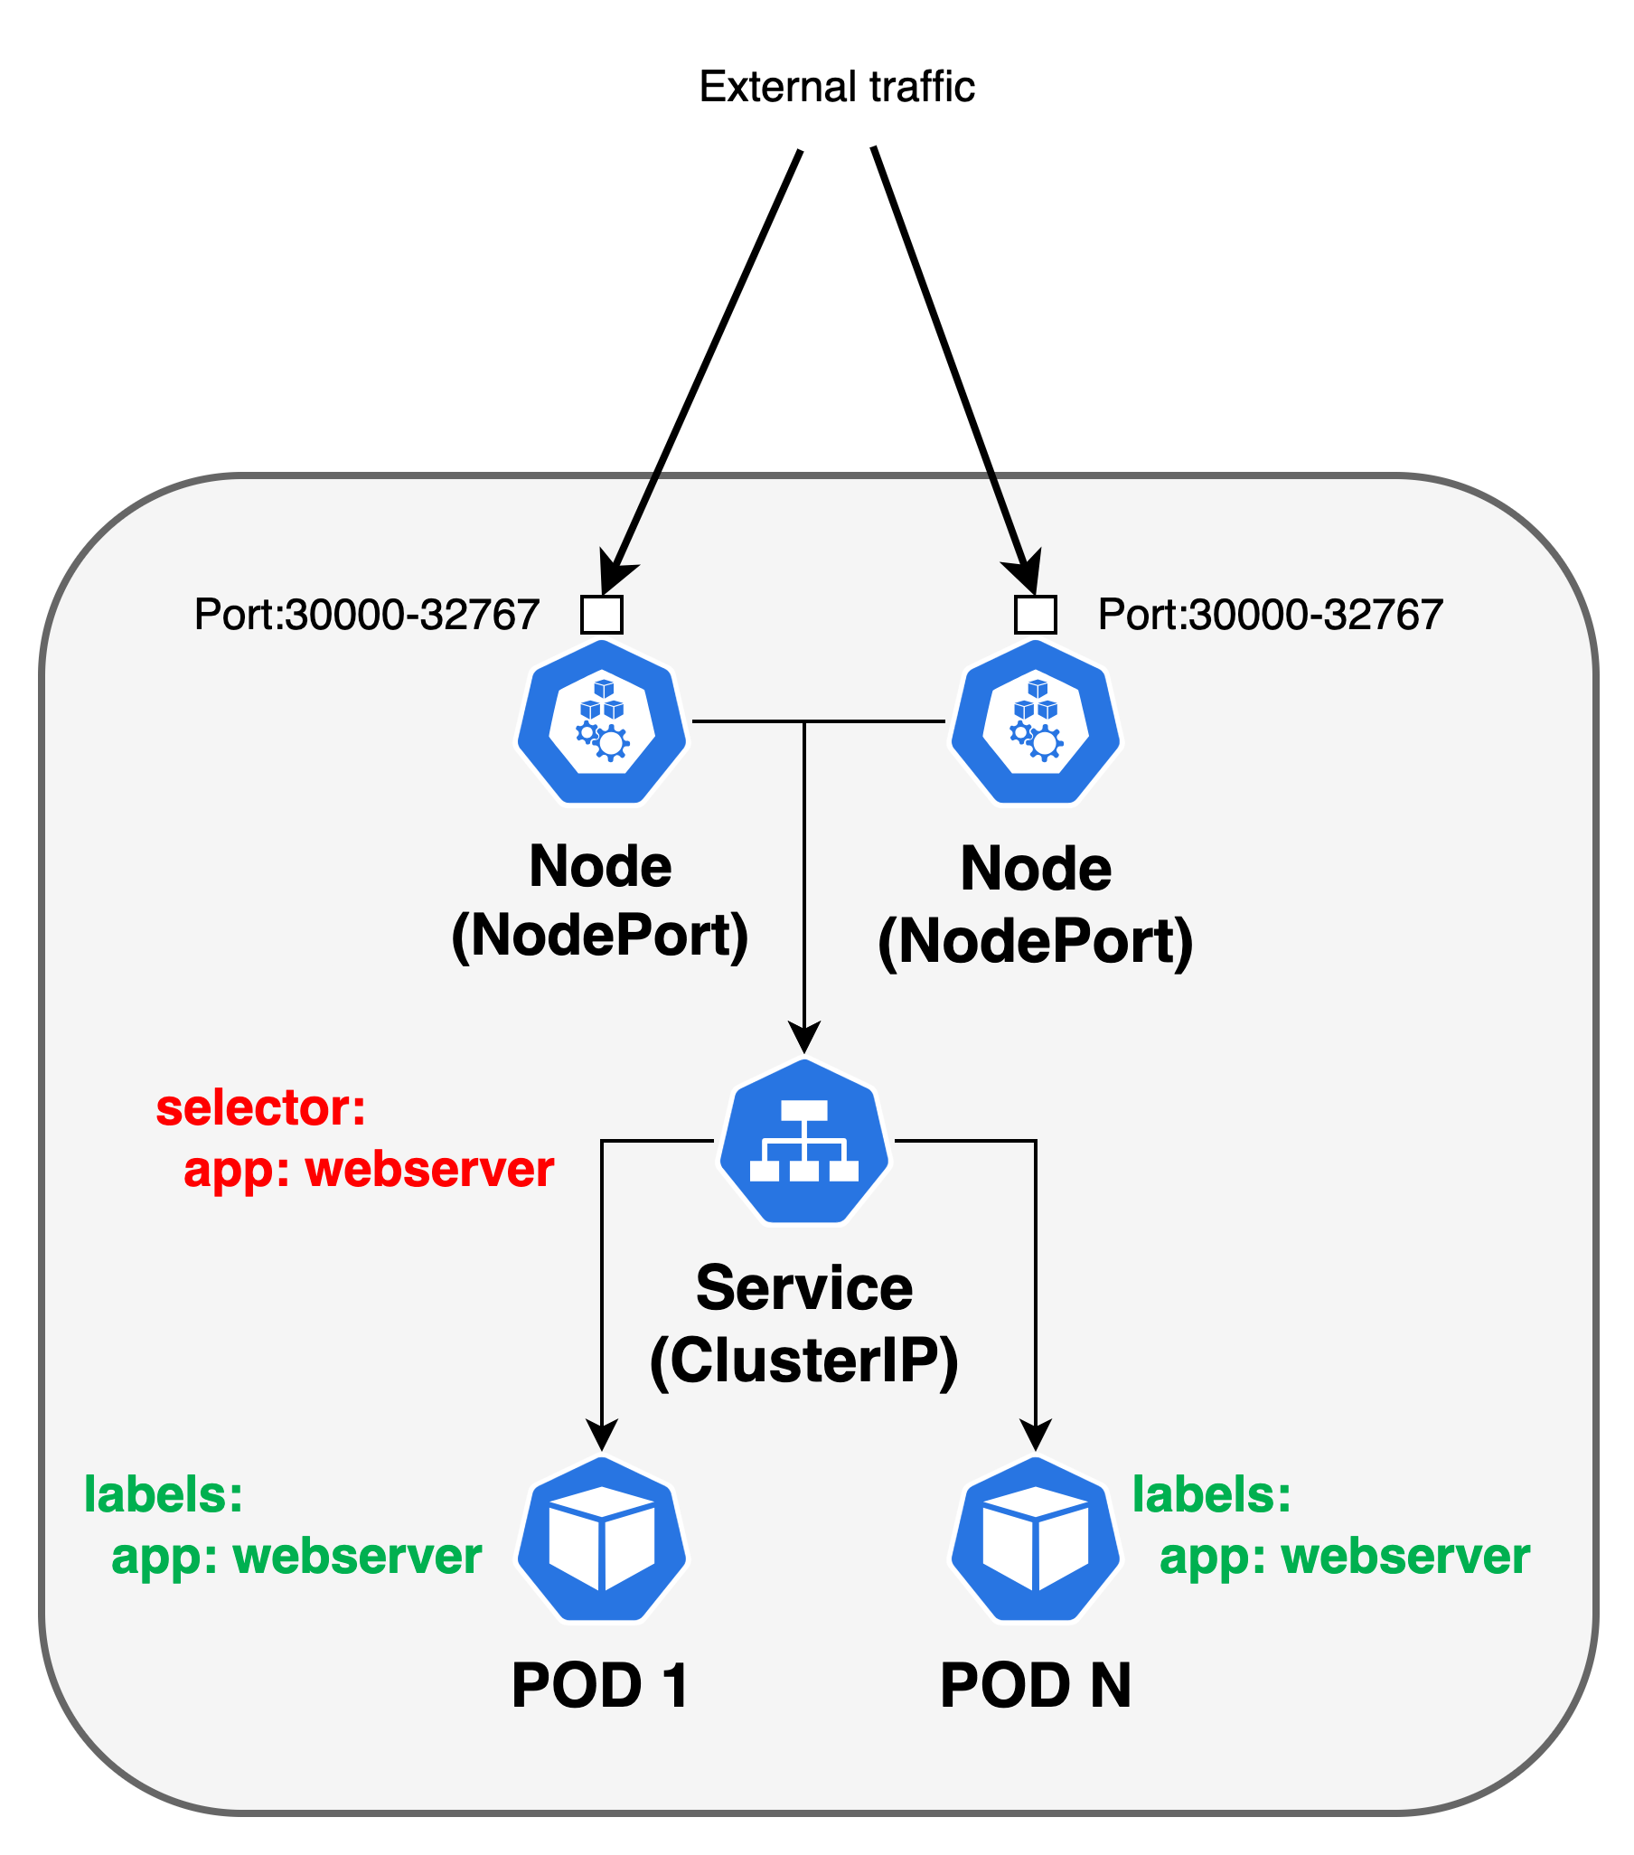
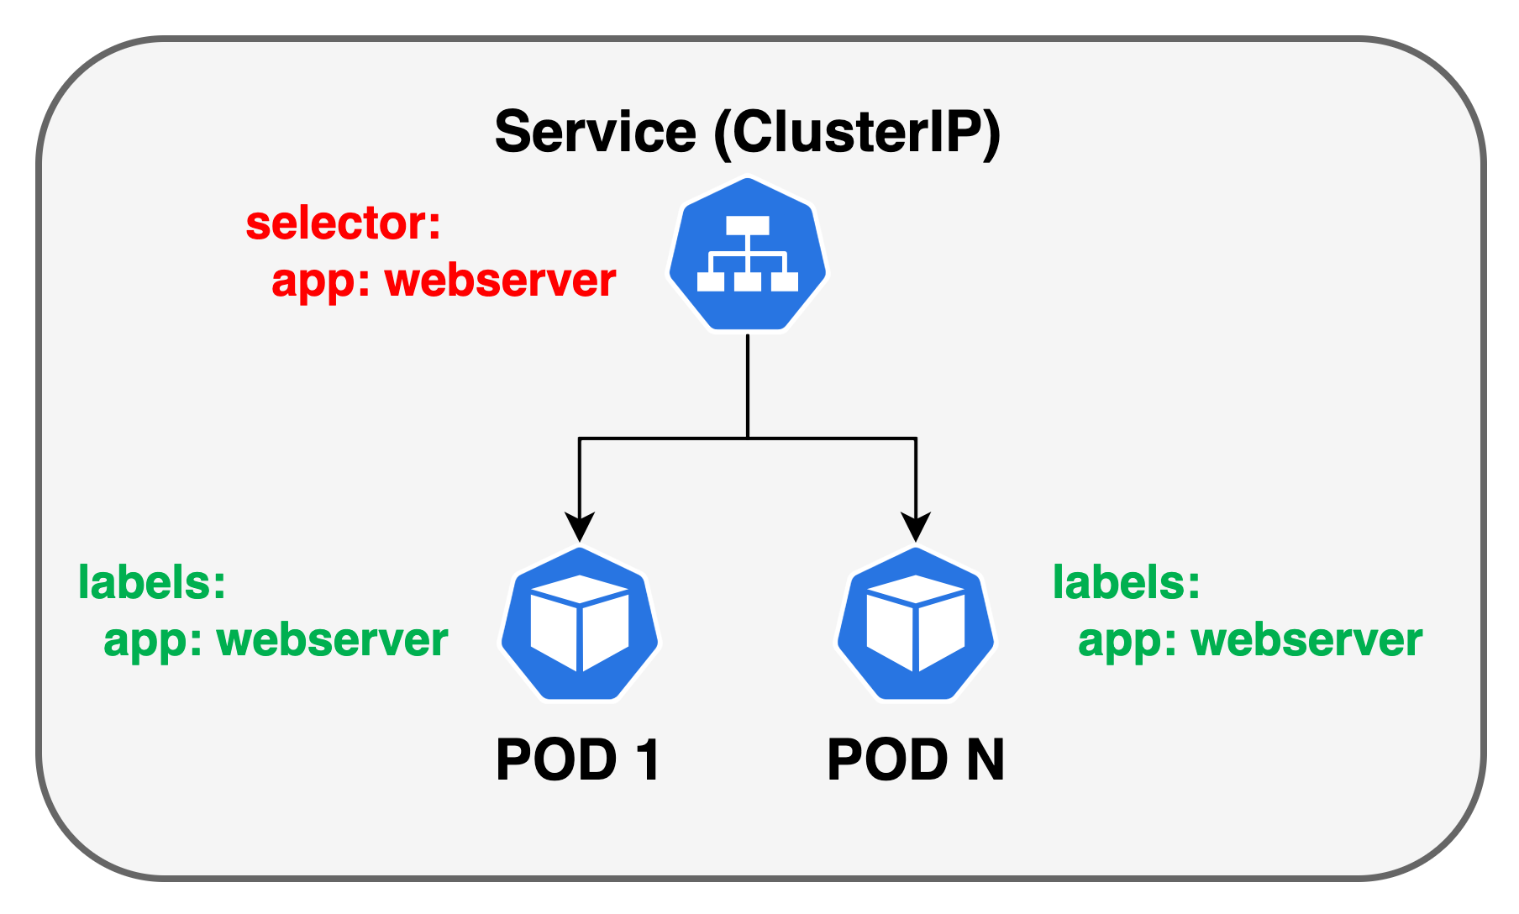
Service Resources
Internal DNS:
webserver-service
webserver-service.default
webserver-service.default.svc.cluster.local
Outside cluster:
minikube service list
curl <node_ip>:<node_port>

Slide 25
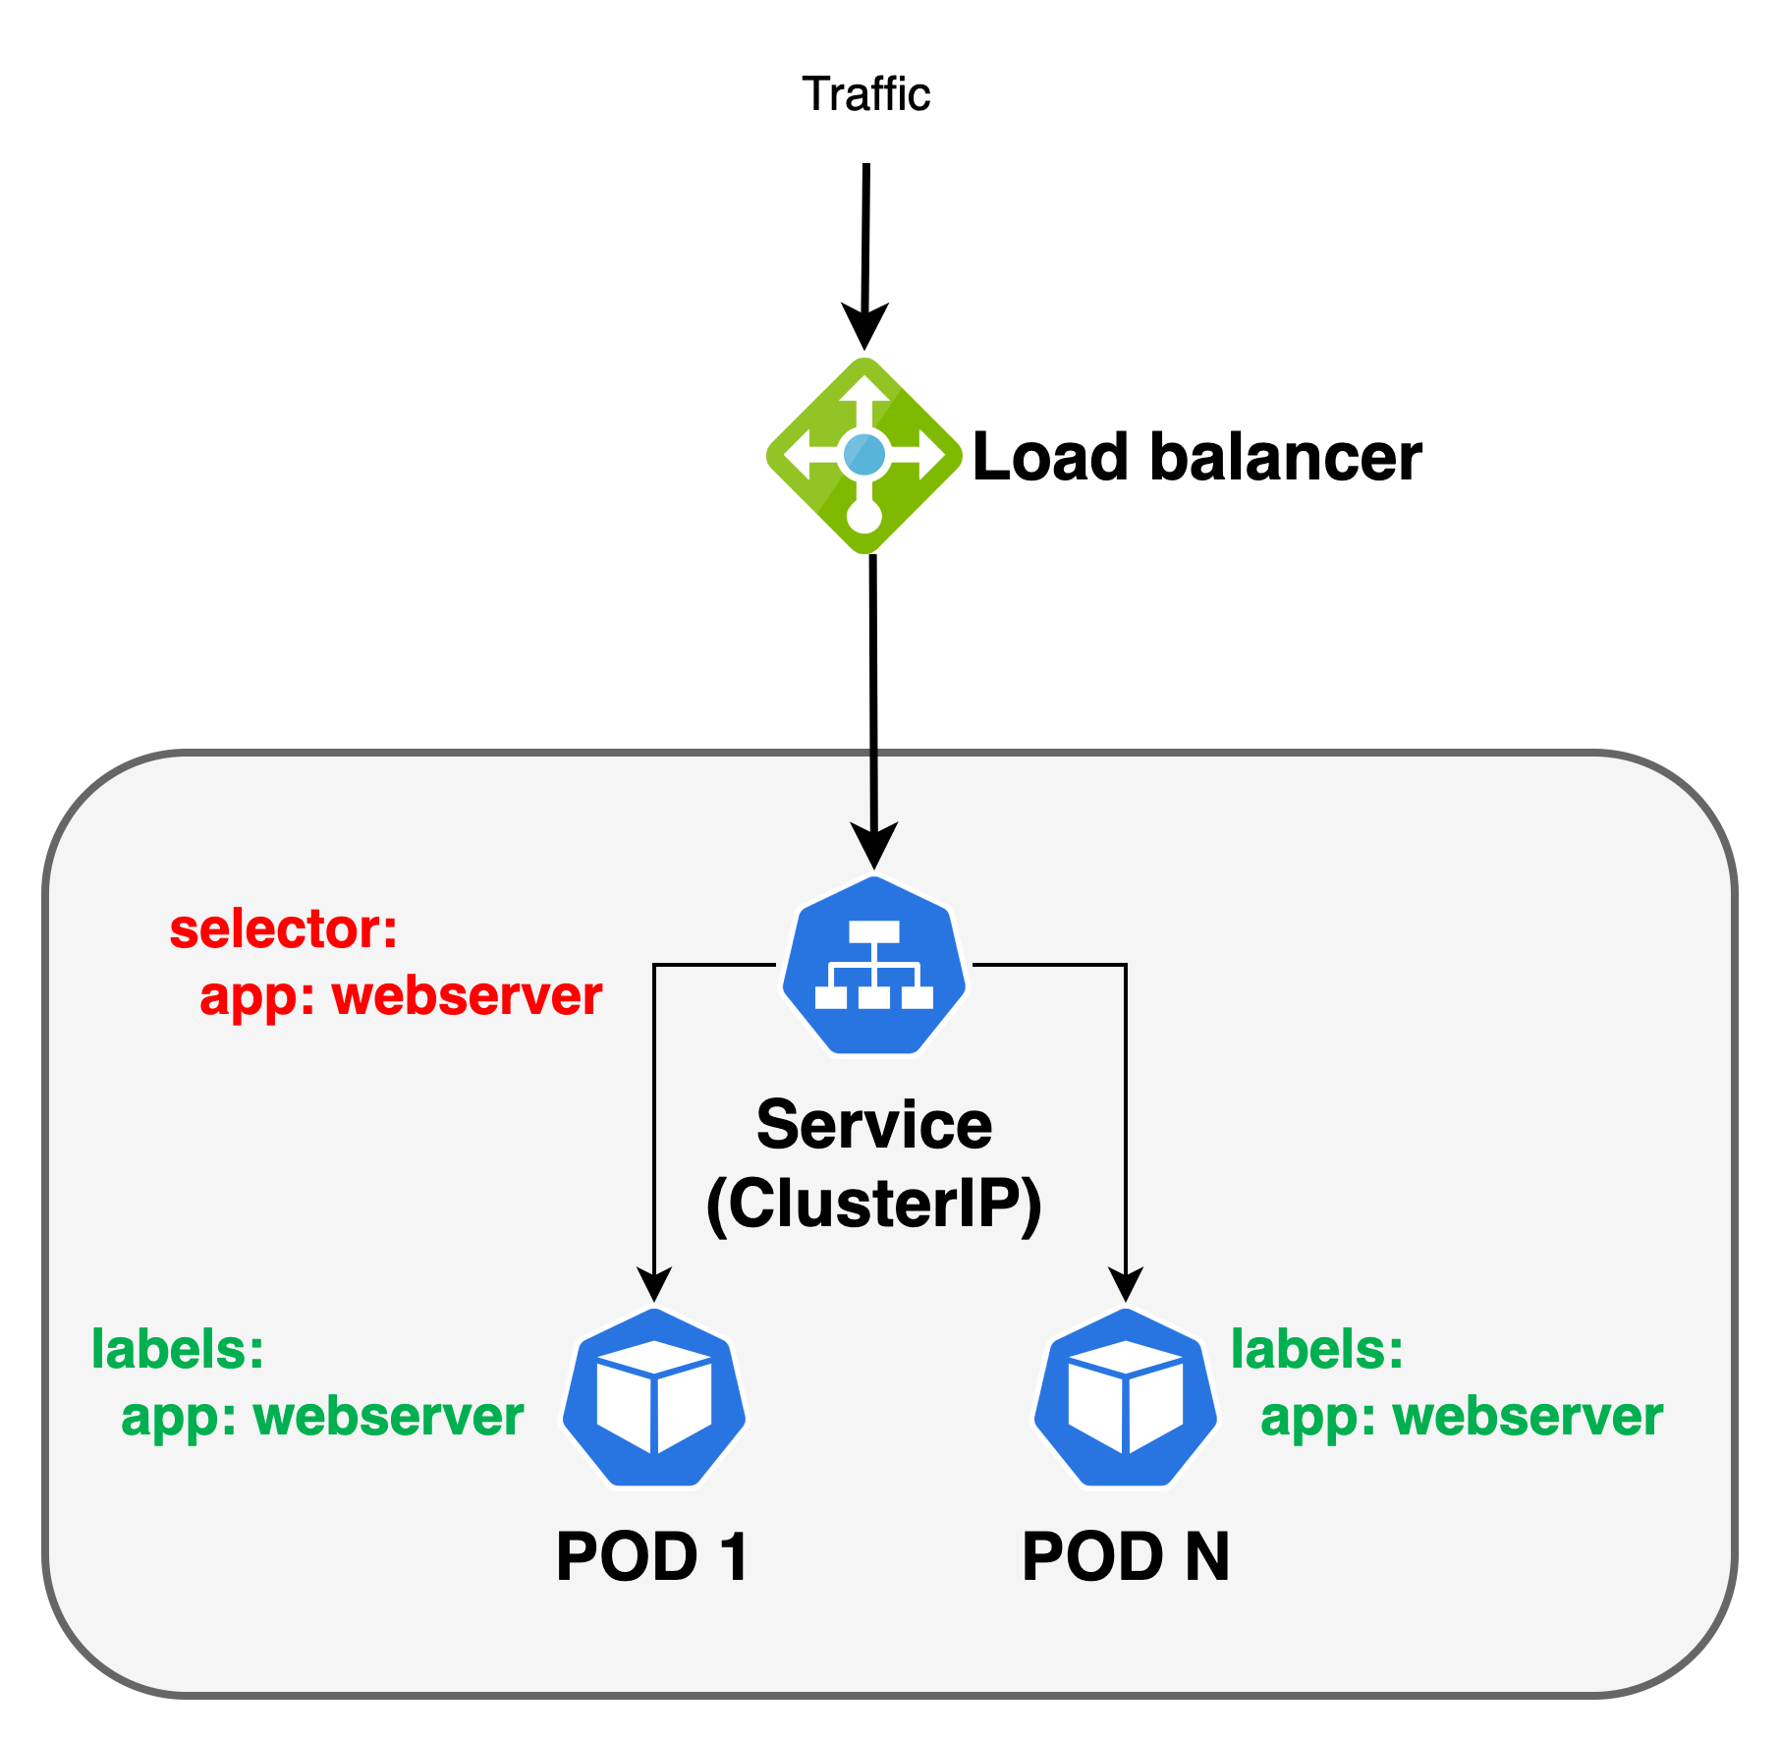
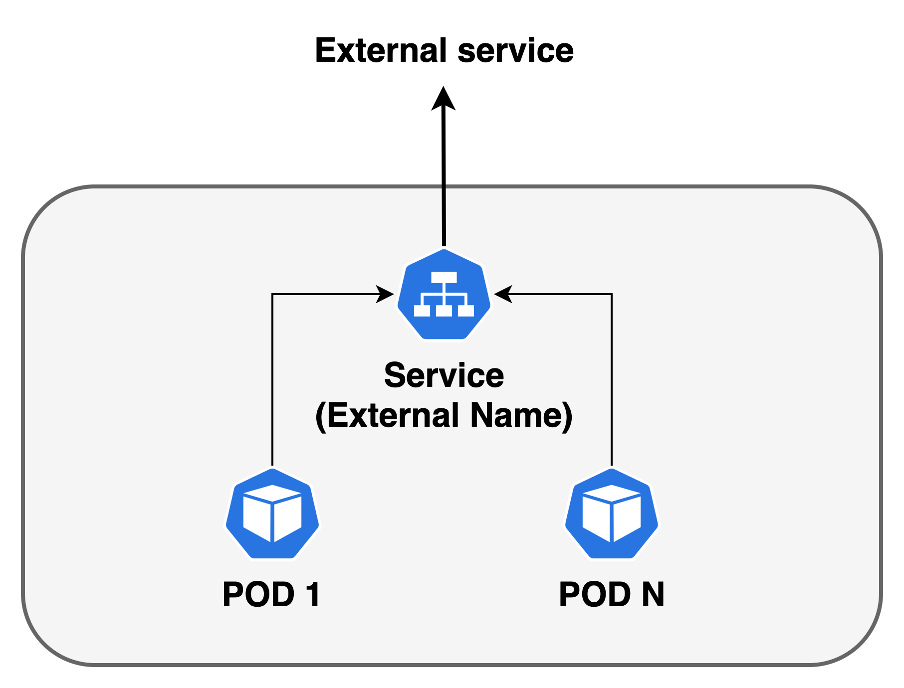
Service Resources
minikube tunnel – to simulate “load balancer”

Slide 26
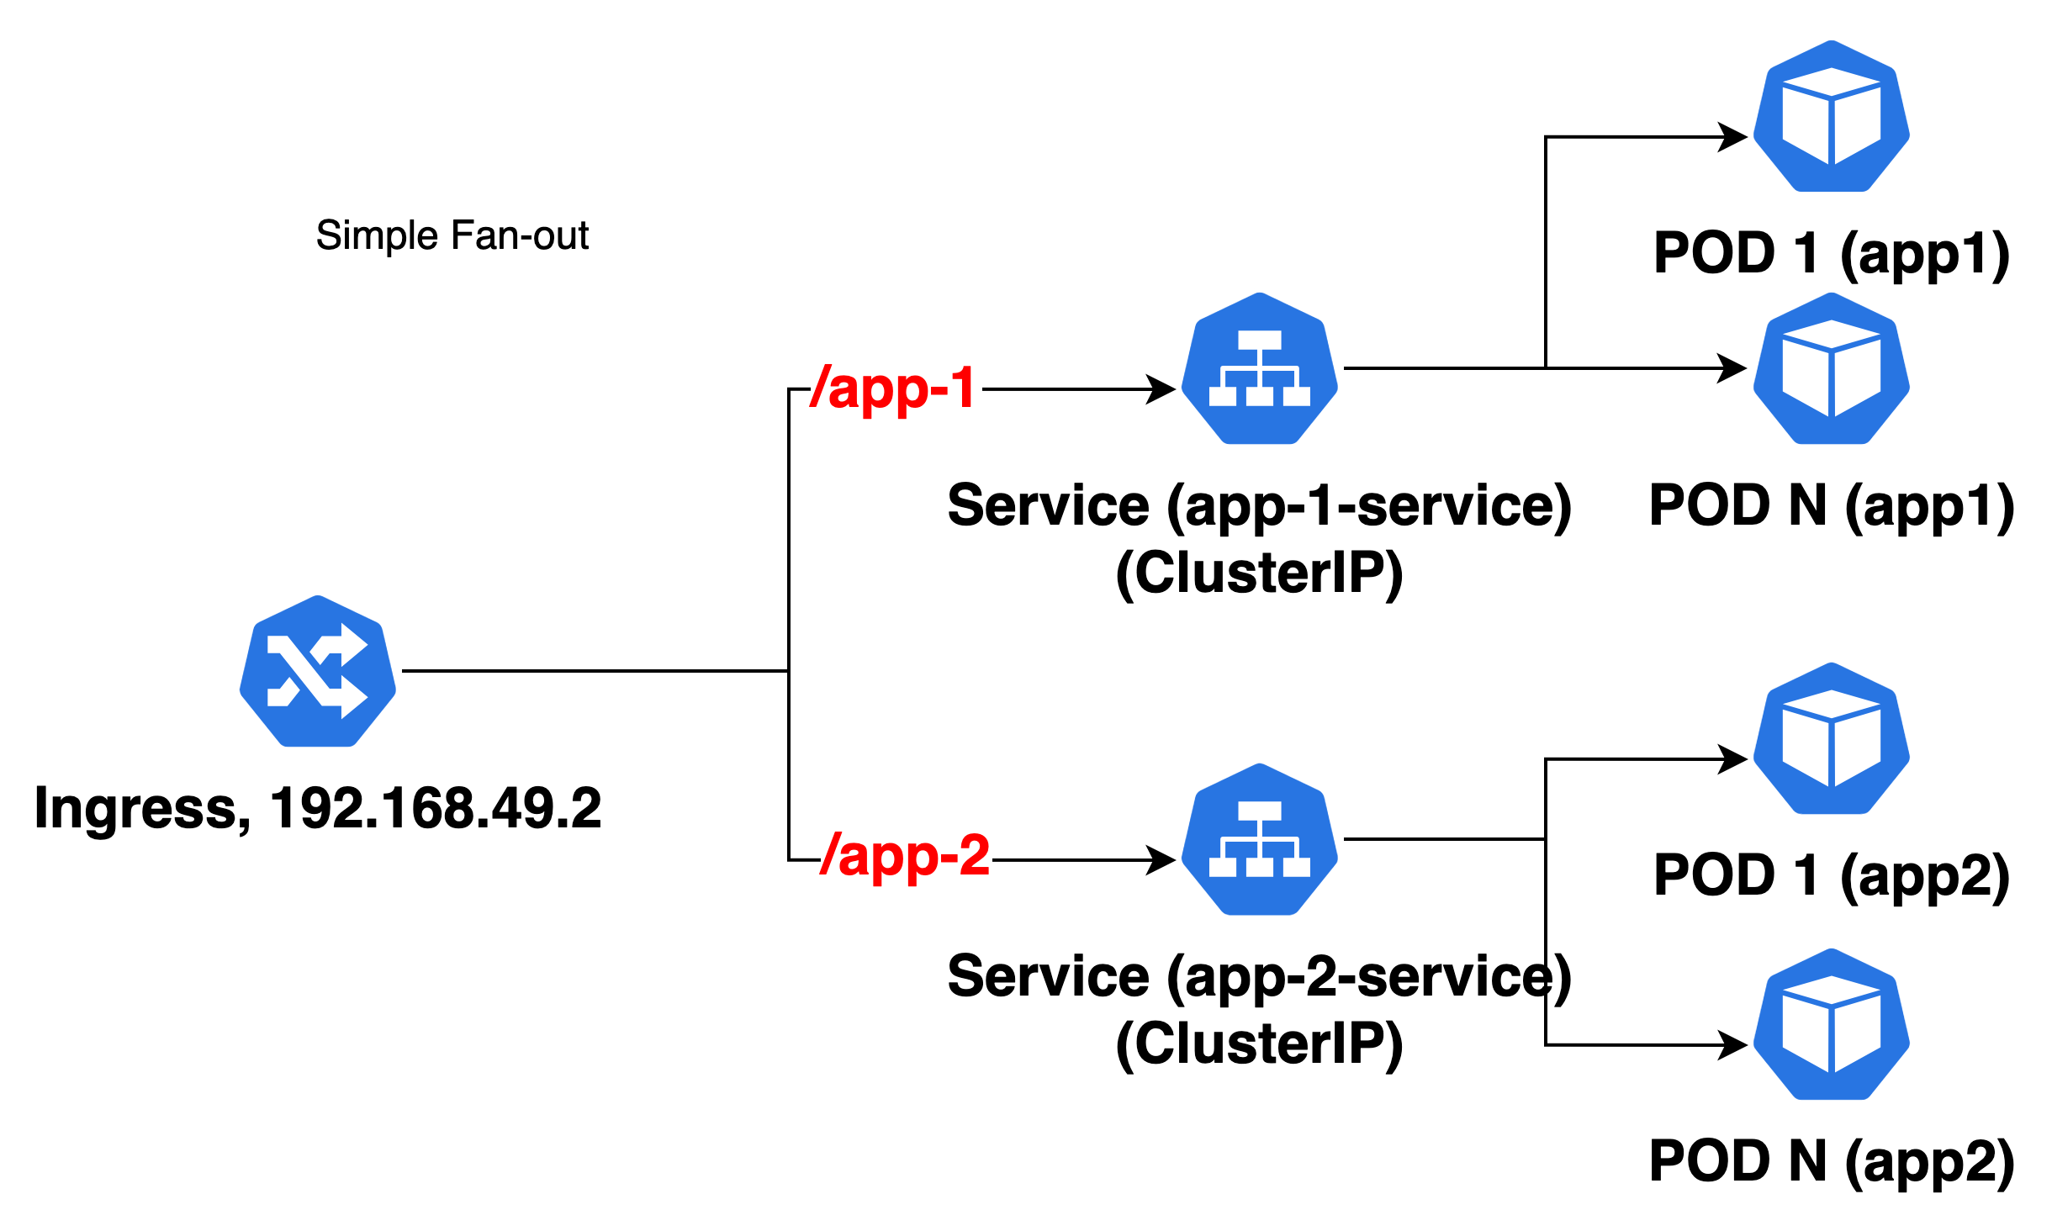
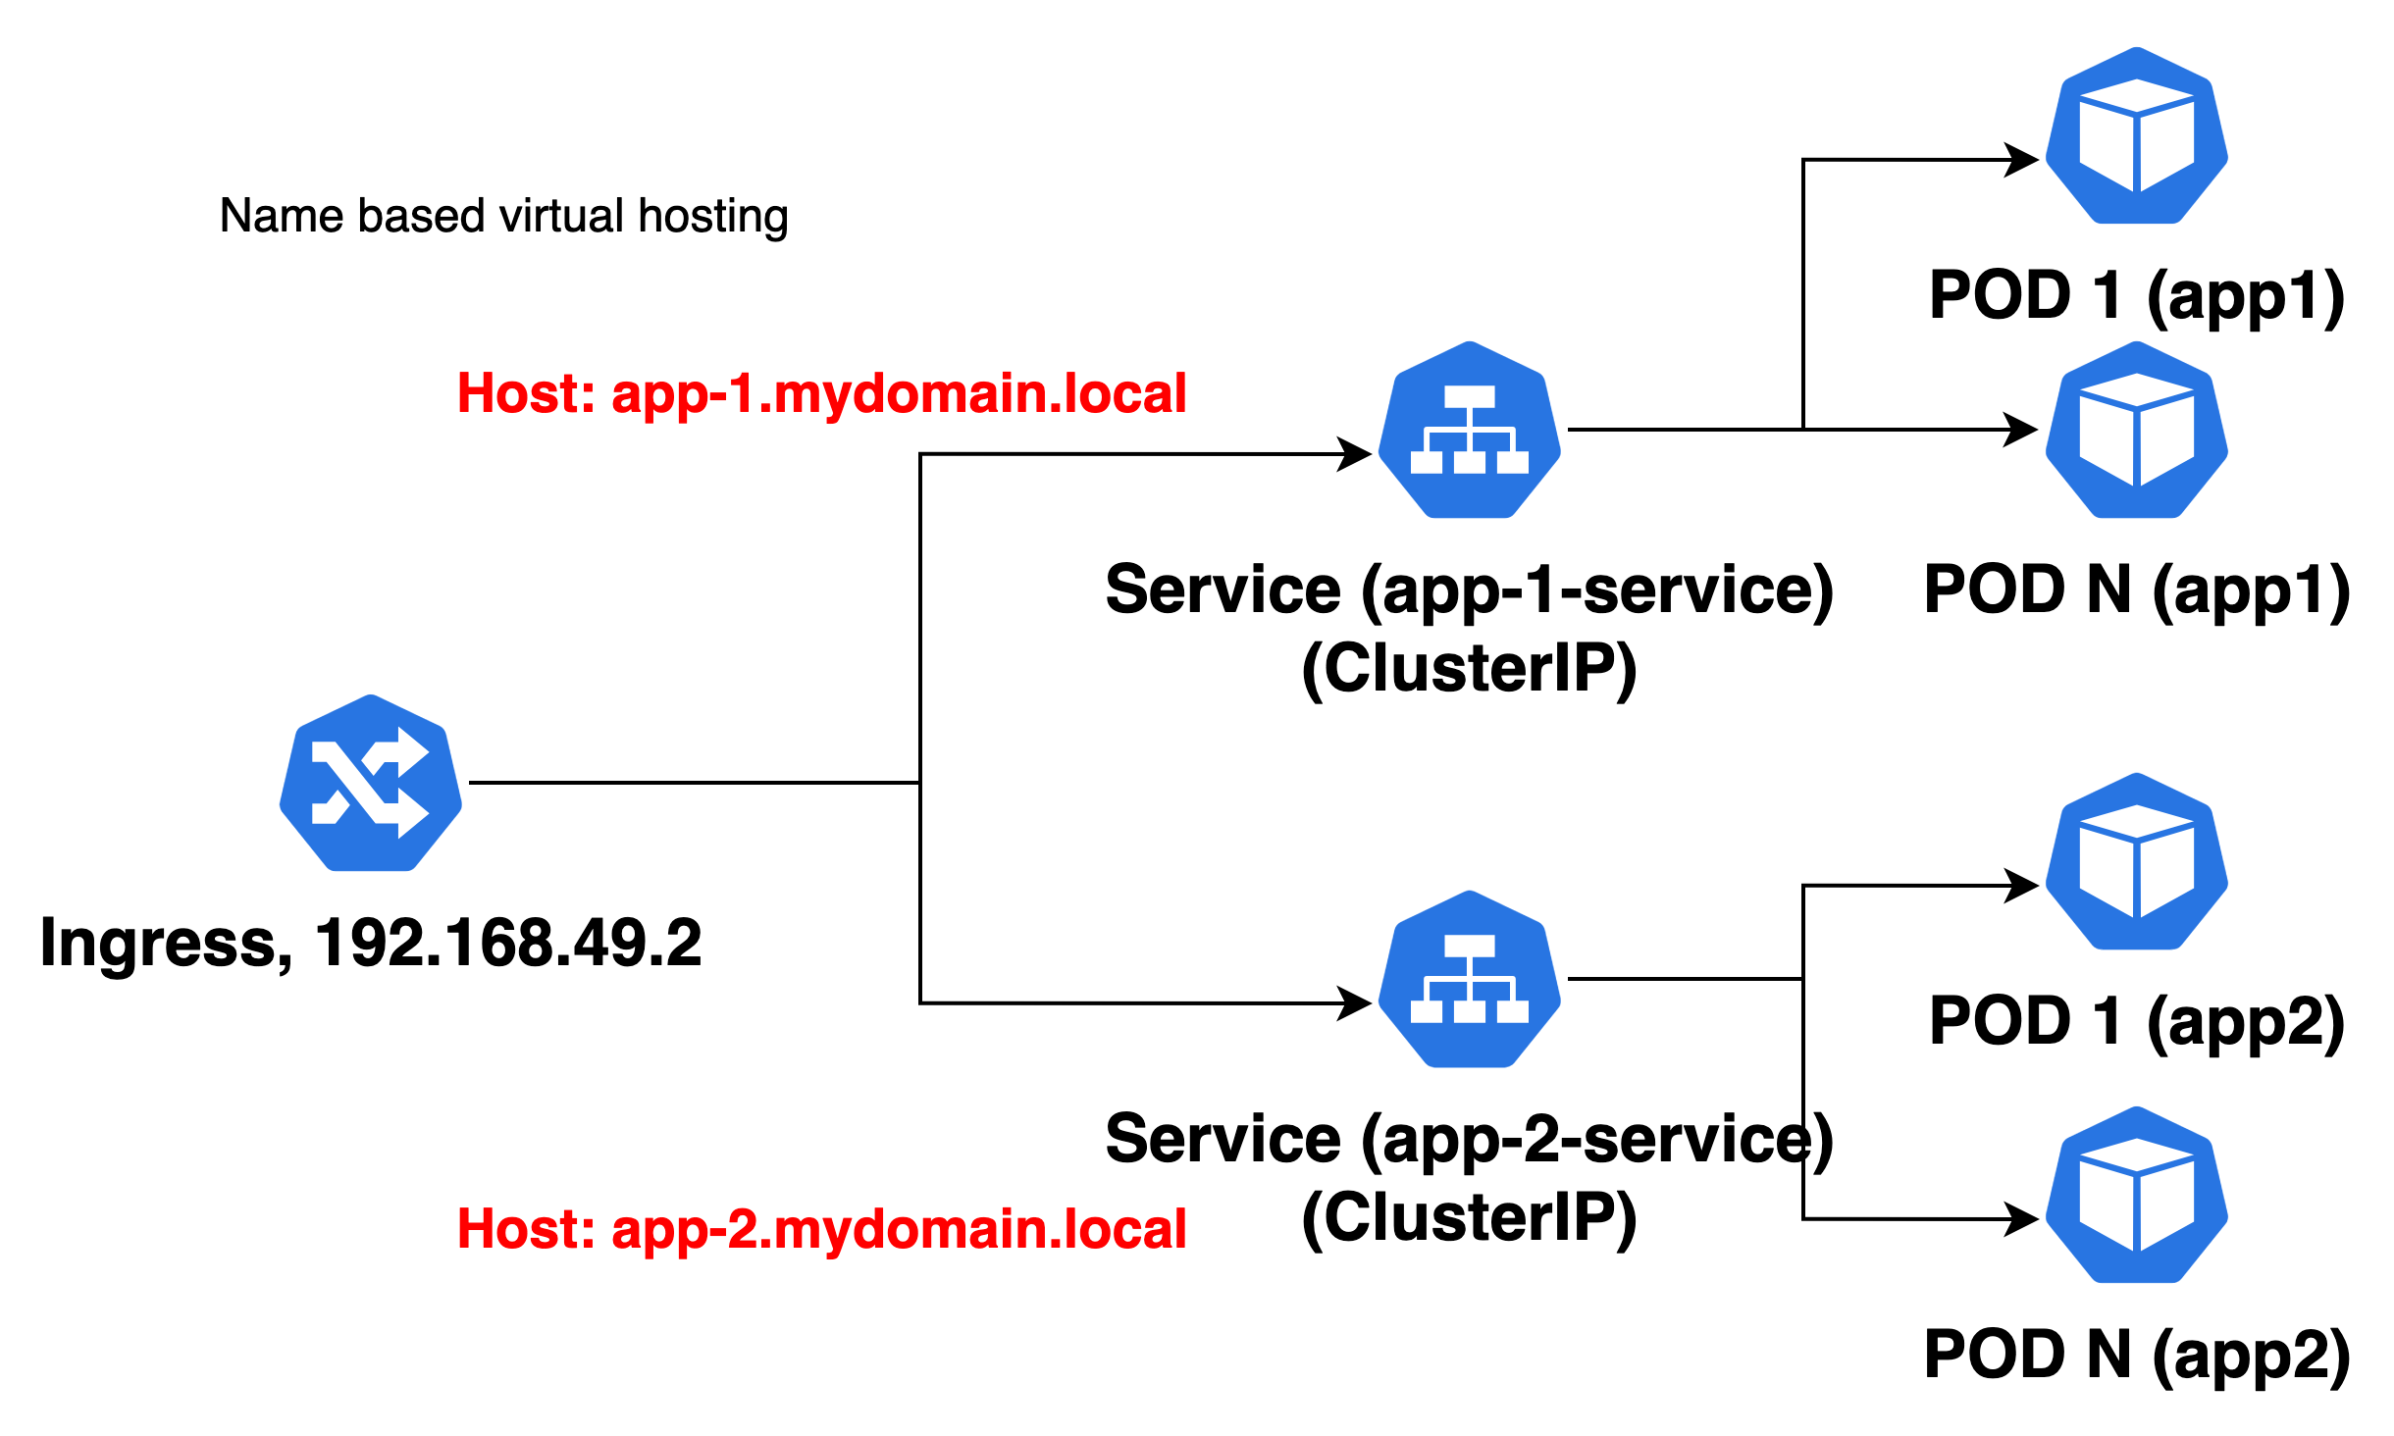
Service Resources
Ingress
Ingress exposes HTTP and HTTPS routes from outside the cluster to services within the cluster. Traffic routing is controlled by rules defined on the Ingress resource,
An Ingress may be configured to give Services externally-reachable URLs, load balance traffic, terminate SSL / TLS, and offer name-based virtual hosting.

Slide 27
Configuration Resources
ConfigMap
A ConfigMap is an API object used to store non-confidential data in key-value pairs. Pods can consume ConfigMaps as environment variables, command-line arguments, or as configuration files in a volume,
A ConfigMap allows you to decouple environment-specific configuration from your container images, so that your applications are easily portable,
Secret
Kubernetes Secret let you store and manage sensitive information, such as passwords, OAuth tokens, ssh keys, TLS certificate and keys. Storing confidential information in a Secret is safer and more flexible than putting it verbatim in a Pod definition or in a container image.
Secrets can be mounted as data volumes or exposed as environment variables to be used by a container in a Pod. Secrets can also be used by other parts of the system, without being directly exposed to the Pod. For example, Secrets can hold credentials that other parts of the system should use to interact with external systems on your behalf.
SealedSecret
Encrypted Secret which is safe to store even to public repository,
The SealedSecret can be decrypted only by the controller running in the target cluster and nobody else (not even the original author) is able to obtain the original Secret from the SealedSecret.

Slide 28
Assigning PODs to nodes (scheduling)
nodeSelector
You can add the nodeSelector field to your Pod specification and specify the node labels you want the target node to have. Kubernetes only schedules the Pod onto nodes that have each of the labels you specify
Affinity and anti-affinity
Affinity/anti-affinity gives you more control over the selection logic. Two types exist:
Node affinity functions like the nodeSelector field but is more expressive and allows you to specify soft rules.
Inter-pod affinity/anti-affinity allows you to constrain Pods against labels on other Pods.
Taints and tolerations
Node affinity is a property of Pods that attracts them to a set of nodes (either as a preference or a hard requirement). Taints are the opposite -- they allow a node to repel a set of pods. Tolerations are applied to pods. Tolerations allow the scheduler to schedule pods with matching taints. Tolerations allow scheduling but don't guarantee scheduling.

Slide 29
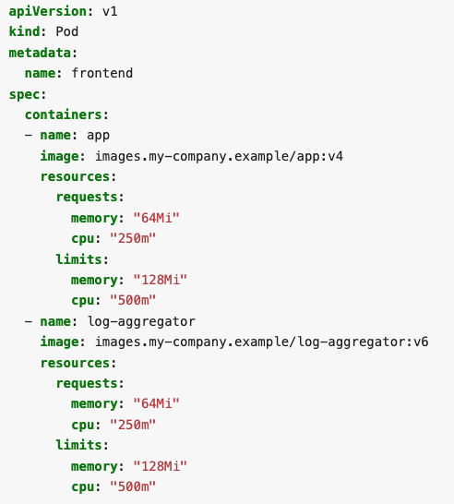
Resource requests and limits
When you specify a Pod, you can optionally specify how much of each resource a container needs. The most common resources to specify are CPU and memory (RAM).
When you specify the resource request for containers in a Pod, the kube-scheduler uses this information to decide which node to place the Pod on.
spec.containers[].resources.limits.cpu
spec.containers[].resources.limits.memory
spec.containers[].resources.limits.hugepages-<size>
spec.containers[].resources.requests.cpu
spec.containers[].resources.requests.memory
spec.containers[].resources.requests.hugepages-<size>
spec.containers[].resources.limits.ephemeral-storage
spec.containers[].resources.requests.ephemeral-storage

Slide 30
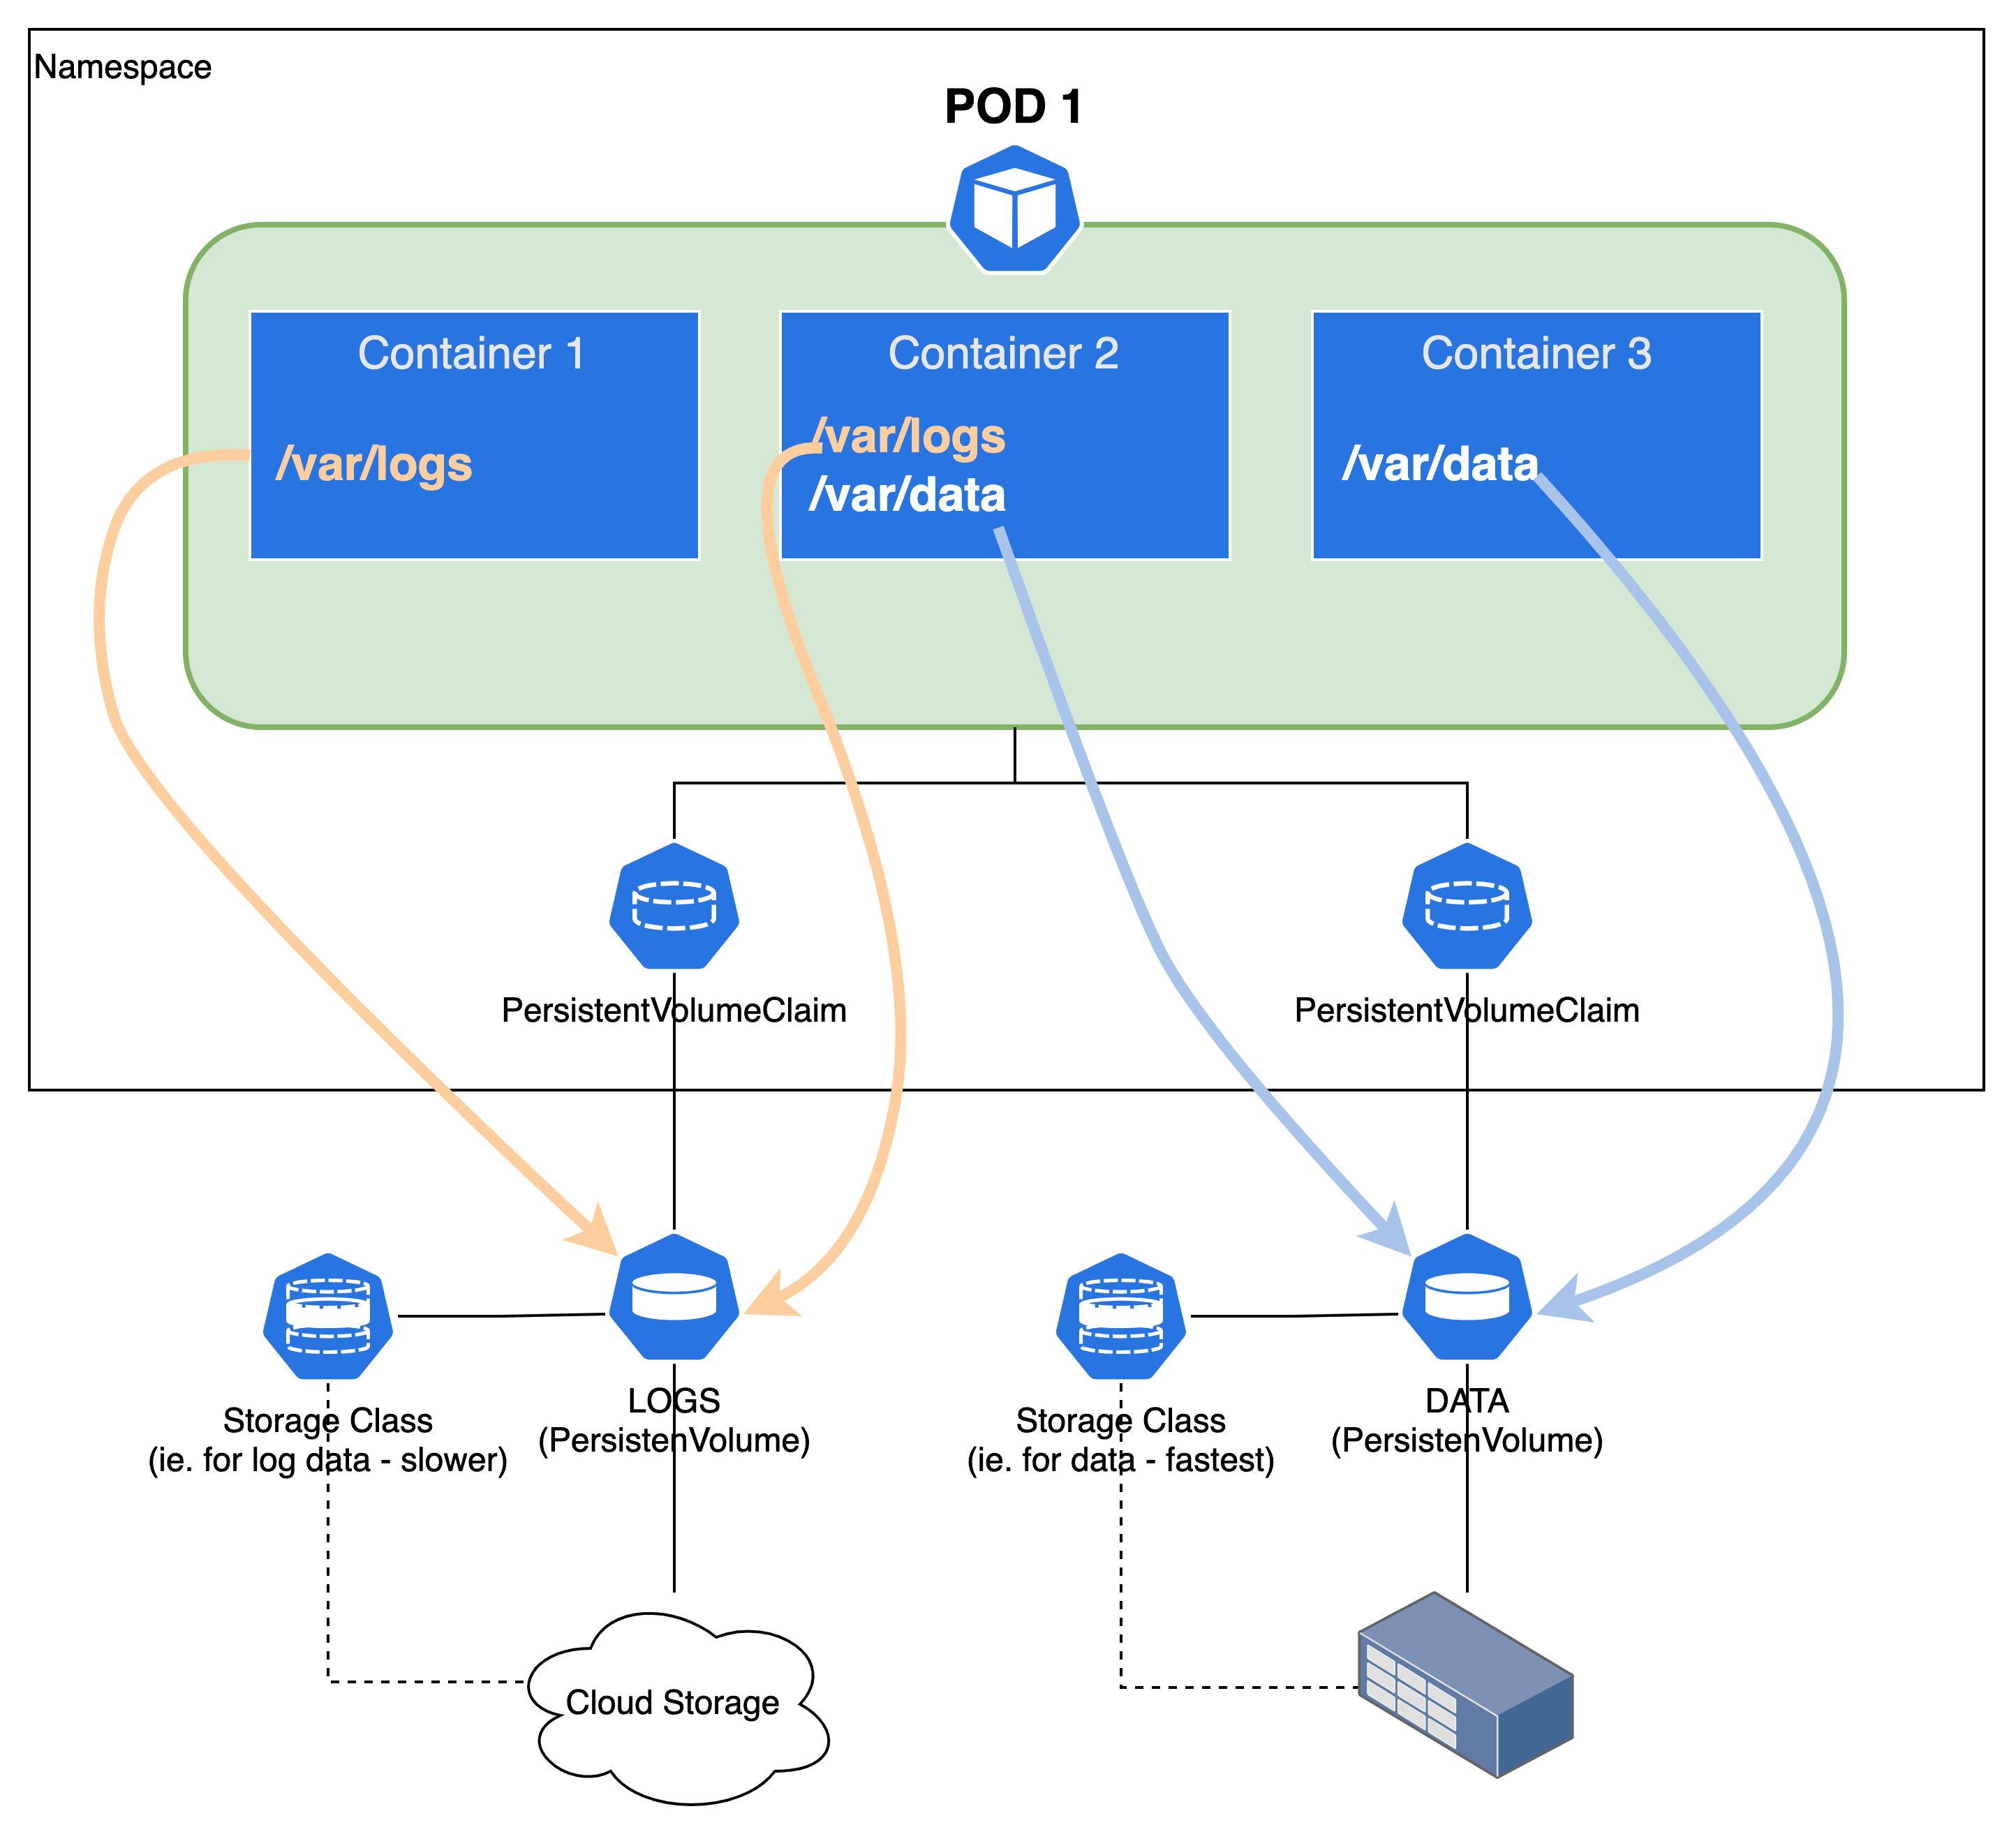
Volumes

Slide 31
Volumes (storage)
Managing storage is a distinct problem from managing compute instances. The PersistentVolume subsystem provides an API for users and administrators that abstracts details of how storage is provided from how it is consumed,
A PersistentVolume (PV) is a piece of storage in the cluster that has been provisioned by an administrator or dynamically provisioned using Storage Classes. It is a resource in the cluster just like a node is a cluster resource. PVs have a lifecycle independent of any individual Pod that uses the PV,
A PersistentVolumeClaim (PVC) is a request for storage by a user. It is similar to a Pod. Pods consume node resources and PVCs consume PV resources. PVC can request specific size and access modes (e.g., they can be mounted ReadWriteOnce, ReadOnlyMany or ReadWriteMany)

Slide 32
Volumes
Examples of persistent volume types:
hostPath - hostPath volume (for single node testing only; will not work in a multi-node cluster).
CSI drivers - Container Storage Interface (CSI) – many drivers are available - https://kubernetes-csi.github.io/docs/drivers.html .
local - local storage devices mounted on nodes.
nfs - Network File System (NFS) storage.
Examples of projected volume types:
secret - secret volumes are backed by tmpfs (a RAM-backed filesystem) so they are never written to non-volatile storage.
configMap - The data stored in a ConfigMap can be referenced in a volume of type configMap and then consumed by containerized applications running in a pod.
Examples of ephemeral volume types:
emptyDir - the volume is created when the Pod is assigned to a node. When a Pod is removed from a node for any reason, the data in the emptyDir is deleted permanently.

Slide 33
Volumes in minikube
Minikube supports multi-node clusters with PV/PVC and volume snapshots after applying
minikube addons enable volumesnapshots
minikube addons enable csi-hostpath-driver
minikube addons disable storage-provisioner
minikube addons disable default-storageclass
kubectl patch storageclass csi-hostpath-sc -p '{"metadata": {"annotations":{"storageclass.kubernetes.io/is-default-class":"true"}}}’
https://minikube.sigs.k8s.io/docs/tutorials/volume_snapshots_and_csi/

Slide 34
DaemonSet (workload resource)
A DaemonSet ensures that all (or some) Nodes run a copy of a Pod. As nodes are added to the cluster, Pods are added to them. As nodes are removed from the cluster, those Pods are garbage collected. Deleting a DaemonSet will clean up the Pods it created
Typical use cases:
Running a cluster storage daemon on every node,
Running a logs collection daemon on every node,
Running a node monitoring daemon on every node

Slide 35
StatefulSet (workload resource)
StatefulSet is the workload API object used to manage stateful applications,
Manages the deployment and scaling of a set of Pods, and provides guarantees about the ordering and uniqueness of these Pods,
StatefulSets are valuable for applications that require one or more of the following:
Stable, unique network identifiers,
Stable, persistent storage,
Ordered, graceful deployment and scaling,
Ordered, automated rolling updates.

Slide 36
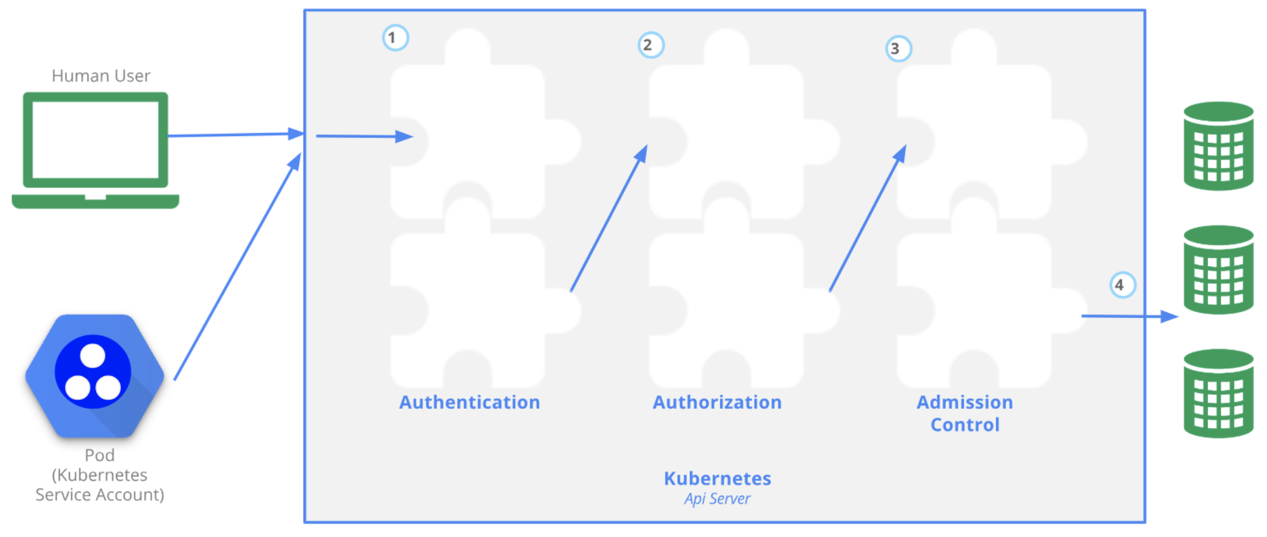
Security
All Kubernetes clusters have two categories of users: service accounts managed by Kubernetes, and normal users,
Authorization modes:
Node - A special-purpose authorization mode that grants permissions to kubelets based on the pods they are scheduled to run,
ABAC - Attribute-based access control (ABAC) defines an access control paradigm whereby access rights are granted to users through the use of policies which combine attributes together,
RBAC - Role-based access control (RBAC) is a method of regulating access to computer or network resources based on the roles of individual users within an enterprise,
Webhook - A WebHook is an HTTP callback: an HTTP POST that occurs when something happens; a simple event-notification via HTTP POST.

Slide 37
Other Kubernetes objects/concepts
Basic Kubernetes has many other objects and concepts:
Jobs, CronJobs
Network Policies
Resource Quotas, Limit Ranges
Custom Resource Definitions
Horizontal Pod Autoscaler
and many others

Slide 38
Thank you very much!
michal.okresa@unicorn.com

